Slide 1
What we have learned from our adult violent death review team
Amy Smith, Deputy Director
Harris County Domestic Violence Coordinating Council

Slide 2
We dedicate our work to all the people affected by Intimate Partner Violence—survivors, family members, friends, co-workers, service providers, law enforcement and especially those who lost their lives as a result.
May we all strive to end violence.

Slide 3
Objectives
What is an Adult Violent Death Review Team
How to work with your local District Attorney and Law Enforcement to create and maintain a team
Understanding the findings and recommendations of an active team

Slide 4
Why Do We Need Death Review Teams?
2015

Slide 5
What is a Death Review Team ?

Slide 6
What Do Adult Violent Death Review Teams Do?
Identify deaths - both homicides and suicides related to domestic violence.
Examine the effects of all domestic violence interventions that took place with the victim and batterer prior to the death(s).
Consider changes in prevention and intervention systems to help prevent such deaths in the future.
Develop recommendations for coordinated community prevention and intervention initiatives to improve system response and reduce domestic violence.
Barbara Hart, Legal Committee, Domestic Violence Death Review, National Council of Juvenile and Family Court Judges, February 9, 1995 (unpublished).

Slide 7
What are the Goals?
To conduct formal, confidential and systematic evaluation and analyses of adjudicated cases of family violence focusing on the flow of each case through the various agencies in the system
To identify areas for improvement or strengthening of agency contacts and interagency response
To evaluate policies, protocols, and practices to identify gaps in service within agencies and the community

Slide 8
Purpose of Death Review Teams Chapter 672 of the Texas Health and Safety Code
A multidisciplinary and multiagency unexpected fatality review team may be established for a county to conduct reviews of unexpected deaths that occur within the county. A review team for a county with a population of less than 50,000 may join with an adjacent county or counties to establish a combined review team
The commissioners court or a county may oversee the activities of the review team or may designate a county department to oversee those activities. The commissioners court may designate a nonprofit agency or political subdivision of the state involved in the support or treatment of victims of family violence, abuse or suicide to oversee the activities of the review team if the governing body of the nonprofit or political subdivision concurs
Effective Sept. 1, 2001 by The 77th Texas Legislature

Slide 9
A meeting of a review team is closed to the public and not subject to the open meetings law, Chapter 551 Government Code
Chapter 672.007 Texas Health and Safety Code

Slide 10
(a) Information and records acquired by a review Team in the exercise of its purpose and duties under this chapter are confidential and exempt from disclosure under the open records law, Chapter 552, Government Code, and may only be disclosed as necessary to carry out the review team’s purpose and Duties.
Chapter 672.009 Texas Health and Safety Code

Slide 11
(c) A member of a review team may not disclose any information that is confidential under this section. (d) a person commits an offense if the person discloses information made confidential by this section. An offense under this section is a class A Misdemeanor
Chapter 672.009 Texas Health and Safety Code

Slide 12
Harris County AVDRT Sign- in Sheet
Team reviews are closed to the public and not subject to the open meetings law. In no case should any team member or meeting attendee disclose any information regarding team decisions outside the team, other than pursuant to team confidentiality guidelines.
The undersigned agree to abide by the terms of this confidentiality agreement.

Slide 13
How to get Started
Review the Statute
Commissioner Court Designation?
Define the team’s goals, purposes, and philosophies
Identify Key Players- D.A., Chief of Police, Sheriff, etc

Slide 14
Who Can Be Or Should Be on the Team?
District Attorney’s Office
Victim Witness Advocate/District Attorney’s Office
Medical Examiner
Medical Forensic Professional
Pathologist
Psychiatrist Or Ph.D. Psychologist
TDPRS/CPS
TDPRS/APS
Local Law Enforcement
Community Supervision And Corrections Department
Public Health Officer
EMS Personnel
Family Violence Center Representative
Domestic Abuse Survivor
Representative From County-based Battering Intervention Program

Slide 15
To Do List…
Develop confidentiality agreements for both individuals and agencies
Decide how cases will be generated- how will the team identify relevant cases and what will the selection criteria include.
Decide how the team will house documents, who will send out meeting notices and generate reports
Establish a meeting schedule that allows for maximum participation- How often will the team meet? How long will the meetings last?

Slide 16
Develop Protocols
What will the team review, including the scope and types of cases- disposed/closed cases, intimate partner homicides, murder/suicide, etc.
Approximately how many cases will be reviewed in a year.
How detailed will the reviews be- review for aggregate data or more in-depth reviews?

Slide 17
What to look for in a Case Review
What was the timeline of events?
Which agencies and/or community entities were involved?
What was the degree of coordination and communication among the agencies and community entities?
What were the possible red flags or risk factors in the relationship?
Is there anything that could have been done differently to improve the systemic and/or community response to the victim and/or the perpetrator?

Slide 18
After the Review
Summarize the review into a workable document for either an immediate or later report.
Determine if there are recommendations.
Determine how and to whom the findings will be disseminated.

Slide 19
Harris County Adult Violent Death Review Team (AVDRT)
Summary of 2015 Report

Slide 20
“I was tempted to call him over, hit her myself and set him up…to just end the madness…for somebody like me to even start thinking like that, it has gotten really bad and you feel like there is no other way out… we’re just not like that, but us not doing something cost her life.”
–Victim’s Mother, Family Interviewing Project

Slide 21
Harris County AVDRT 2015 Team Members
Aid to Victims of Domestic Abuse
The Bridge Over Troubled Waters, Inc.
Cenikor’s Odyssey House
Harris County District Attorney’s Office, Victim Witness Division
Harris County Domestic Violence Coordinating Council
Harris County Sheriff’s Office, Homicide Division and Family Violence Unit
Houston Area Women’s Center
Houston Community College
Houston Police Department, Homicide and Special Victims Divisions
Northwest Assistance Ministries, Family Violence Center
TDFPS, CPS and APS
Shalom Bayit
University of Houston, Graduate School of Social Work

Slide 22
2014 Harris County Stats
28 women were killed by their intimate partner
32,872 calls were made to Law Enforcement
Over 72,000 calls were made to a domestic violence hotline
Over 2,500 were provided shelter
Over 13, 000 were unable to be sheltered due to lack of space

Slide 23
“I never thought he would hurt her, up until the very end when they separated the last time. That’s when I started believing he would actually hurt her, because . . . he had tried everything, there was nothing left for him to try.”
–Victim’s Mother, Family Interviewing Project

Slide 24
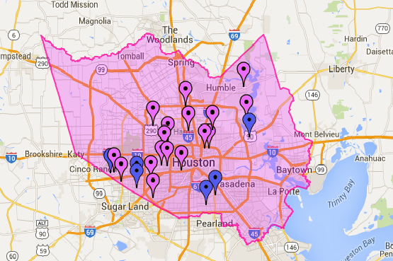
2015 report includes information from 17 cases of intimate partner homicide in Harris County, TX from 2010-2012
Harris County, TX: The purple markers represent the zip codes of the 17 cases we reviewed and the blue markers represent the 6 cases provide to us that we did not have time to review.

Slide 25
“When she died, it was at that point when the police asked me was she abused. ‘What do you mean?’ She had marks and things on her back . . . we never knew . . . the way that he did her, it was violent, it was very, very violent”
–Victim’s Mother, Family Interviewing Project

Slide 26
Summary Data of Cases Reviewed
41% gunshot wounds (7 of 17)
23% from stab wounds (4 of 17)
18% strangulation (3 of 17)
11% (2 of 17) cases reviewed, the perpetrator committed suicide after killing the victim
In both cases the perpetrator was a male and the method of suicide was a gunshot to the head.

Slide 27
41% perpetrators (7 of 16) had drugs and/or alcohol in their system at the time of the homicide
“she was high spirited, very high spirited, and very ambitious . . . and she had a heart, a heart of gold . . . all of a sudden, that spirit . . . came all the way down . . . if she walked out the door, she had to call and let him know that she walked out the door and I got to thinking, there is something not right with this . . . that’s not a healthy relationship if you have to call every time you make a move”
–Victim’s Mother, Family Interviewing Project

Slide 28
“she was high spirited, very high spirited, and very ambitious . . . and she had a heart, a heart of gold . . . all of a sudden, that spirit . . . came all the way down . . . if she walked out the door, she had to call and let him know that she walked out the door and I got to thinking, there is something not right with this . . . that’s not a healthy relationship if you have to call every time you make a move”
-Victim’s Mother, Family Interviewing Project

Slide 29
Summary Data of Cases Reviewed
53% (9 of 17), the homicides occurred at a shared residence

Slide 30
“My daughter’s name wasn’t on the lease. People say they didn’t even know she was there. That’s how isolated it was.”
–Victim’s Mother, Family Interviewing Project

Slide 31
Summary Data of Cases Reviewed
88% of cases reviewed (15 of 17), the murders occurred between Friday and Monday
76% of the cases reviewed (13 of 17), the murder occurred between 12am and 10:30am

Slide 32
Summary Data of Cases Reviewed

Slide 33
Relationship…
58% were dating (10 of 17)
41% were married (7 of 17), including common law and those who were separated with no divorce pending.
One of the 17 cases was a same sex relationship.
82% of the cases (14 of 17), the victims and perpetrators were living together at the time of the incident

Slide 34
Age Group Breakdown
47% of victims were younger than the perpetrator (8 of 17)
Females were on average 12 years younger than the perpetrator

Slide 35
“She loved him, yes she did, but I really think [she] probably would have ended that relationship long before she did if it had not been for her kids”
–Victim’s Mother, Family Interviewing Project

Slide 36
Children
9 cases included children, equating to more than half of the victims having children
55% of those cases - all children were in common between the victim and the perpetrator
23 children lost one or both parents

Slide 37
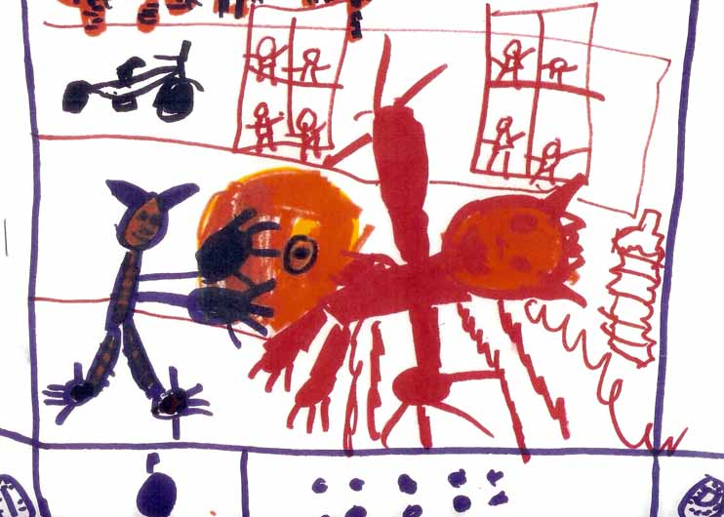
“We [children] didn’t talk, we were scared . . . what he would do to us . . . he would whoop us, but it wasn’t like the normal whopping, it was like for real…”
–Victim’s Daughter, Family Interviewing Project

Slide 38
Children Present During Incident
44% the murder occurred while children were present in the home
35% (8)children being present at the time of the homicide
50% of them witnessed the event or discovered the body (4 of 8).

Slide 39
Perpetrator Criminal History
69% had a non-domestic violence related criminal history (11 of 16)
56% had a prior history of violence (documented involvement with the legal system, law enforcement, or a protective order (9 of 16))
44%had contact with the police in the year prior to the homicide (7 of 16)
31% had prior reports to the police by the victim alleging domestic violence (5 of 16)

Slide 40
“. . . he would time how long it would take the police officers to get there and he would always tell her . . . ‘I could do anything to you and get away because it takes them x amount of time to get here’ . . . it was as simple as his word against ours . . . we still called them . . . if something happened . . . we need a record of how many times we tried, this boy has been stalking us”
–Victim’s Mother, Family Interviewing Project

Slide 41
Risk Factors
88% of cases - perpetrators had a history of violence (14 of 16)
43% of cases - victim had previously attempted to leave the abuser (7 of 16)
19% of the cases the perpetrator had previously threatened to kill the victim (3 of 16)
19% of cases, the perpetrator had access to firearms (3 of 16)

Slide 42
Sentencing
Sentencing ranged from 20 years to life without parole
69% of cases resulted in a plea deal (9 of 13).
The average sentence for a plea deal (not including the 2 life sentences) is 36 years
The average sentence for a jury trial is 31 years

Slide 43
2016 AVDRT Recommendations
Strengthen the lines of communication among agencies and organizations
Identify additional opportunities and continue current efforts to increase public awareness of available resources for all survivors and perpetrators of domestic violence.
Increase and strengthen our educational efforts to prevent deaths due to domestic violence
Increase awareness of the societal imperative to recognize the magnitude of the problem and the difficulties associated with identifying, investigating and prosecuting domestic violence deaths
Educate law makers, government and public officials and members of the criminal justice system about the increasing magnitude of mistreatment in our community, and the need for more rigorous action and increased funding to combat the problem.
Develop a process for retaining information on previous protective orders after their expiration date in law enforcement databases.

Slide 44
2016 AVDRT Recommendations
Advocate for the creation of a statewide repository for domestic violence fatality review information through state legislation.
Advocate for a Statewide Conference for dissemination of information, sharing of lessons learned and increasing dialogue among teams across the state.
Continue collaboration with the District Attorney’s Office to increase information presented in the sentencing phase of a trial, including information about the risk and lethality that was present in the relationship and the context around the history of violence between the victim and perpetrator.
Research and identify opportunities to engage individuals and families that have lost loved ones due to domestic violence homicides, including ongoing support, education, and advocacy.

Slide 45
“. . . if you feel it . . . you know there’s things out of the ordinary, I would tell the parent or whoever, if there’s something out of the ordinary, if they stop calling . . . find out what’s going on . . . anybody, if you see something . . . if it’s out of the ordinary, say something . . nobody knew nothing, nobody called.”
–Victim’s Mother, Family Interviewing Project

Slide 46
www.hcdvcc.org
281-400-3690

